Slide 1

SC1015 Mini Project
HR Analytics: Job Change of Data Scientists
DSF 2
Zhang KaiChen
Wong Wei Kai
Max Tan Han Xian
Notes:
Hello, we are from group 6 and our group consists of KaiChen, Wei Kai, and Max. Welcome to the video presentation of our SC1015 Mini Project: HR Analytics: Job change of data scientists.

Slide 2

Pratical Motivation
Goals
Identify key factors
Gain data insights
Problem Statement
Predict whether a person will move to a new job based on features such as demographics, education and working experience.
Notes:
Firstly, we will introduce our practical motivation. This dataset is about the information of the candidates who have enrolled into a data science company’s training program. The company wants to know among all these candidates who have an interest in finding a new job such that it can provide them with a more suitable training course. Hence, our main goal is to find out the related factors and try to gain some data insights from this dataset. Our problem statement is to predict whether a person will move to a new job based on features such as demographics, education and working experience of the person.

Slide 3
Data Preparation & Problem Formulation
Sample Collection
Retrieved from Kaggle:
https://www.kaggle.com/datasets/arashnic/hr-analytics-job-change-of-data-scientists
Data Science Problem
Categorical Prediction:
Binary classification problem – Predict Job Seekers & Non Job-Seekers
Notes:
Next, we will talk about data preparation and problem formulation. This dataset is retrieved from Kaggle, and our data science problem is a binary classification problem which we have to classify job seekers and non-job seekers.

Slide 4
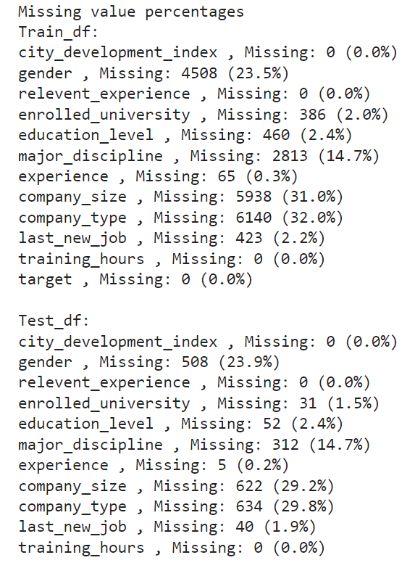
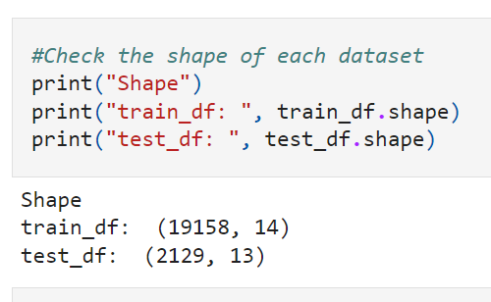
Reason for choosing this Dataset
Appropriate size
Consists of 14 features and about 20000+ datapoints
Enough space for Data Cleaning
Some of the features have missing value or improper labels
Problem is Intuitive & Straightforward
It is a binary classification problem that predicts if a person is Job-Seekers or Non Job-Seekers
Notes:
The reason why we choose this dataset is because it has a moderate number of features and datapoints such that it is suitable for us to perform data analysis and machine learning. Furthermore, this dataset has some missing values and improper labeling, so we have enough space to demonstrate data cleaning. Lastly, we can construct a clear and intuitive data science problem which we can solved by demonstrating our learning outcomes in this course.

Slide 5
Data Cleaning
Notes:
Next, let's move on to data cleaning.

Slide 6
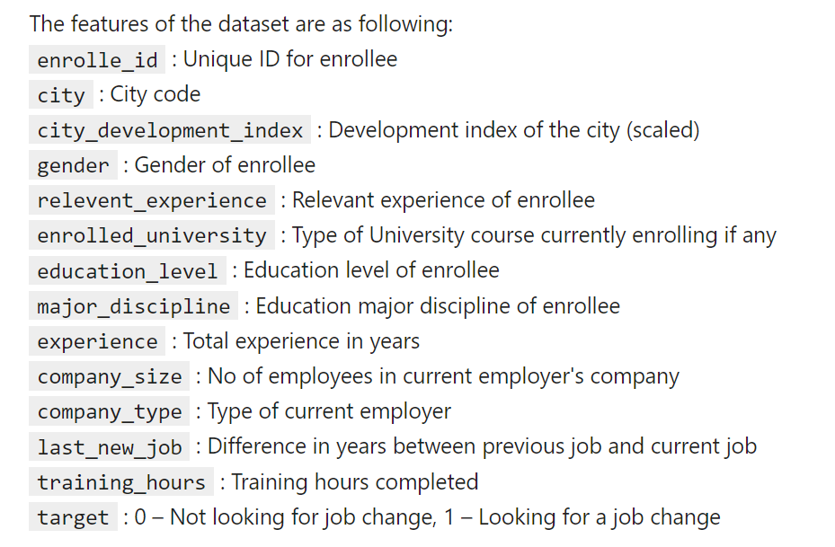
Checking the features
Notes:
We first need to check the features in this dataset such that we can remove irrelevant columns that are useless or inconvenient to use.

Slide 7
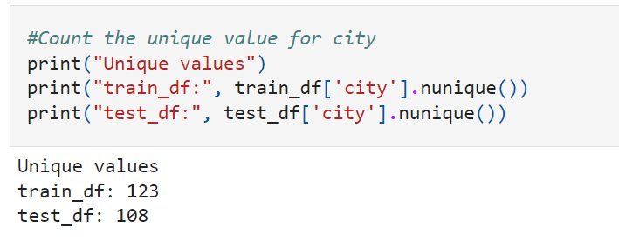
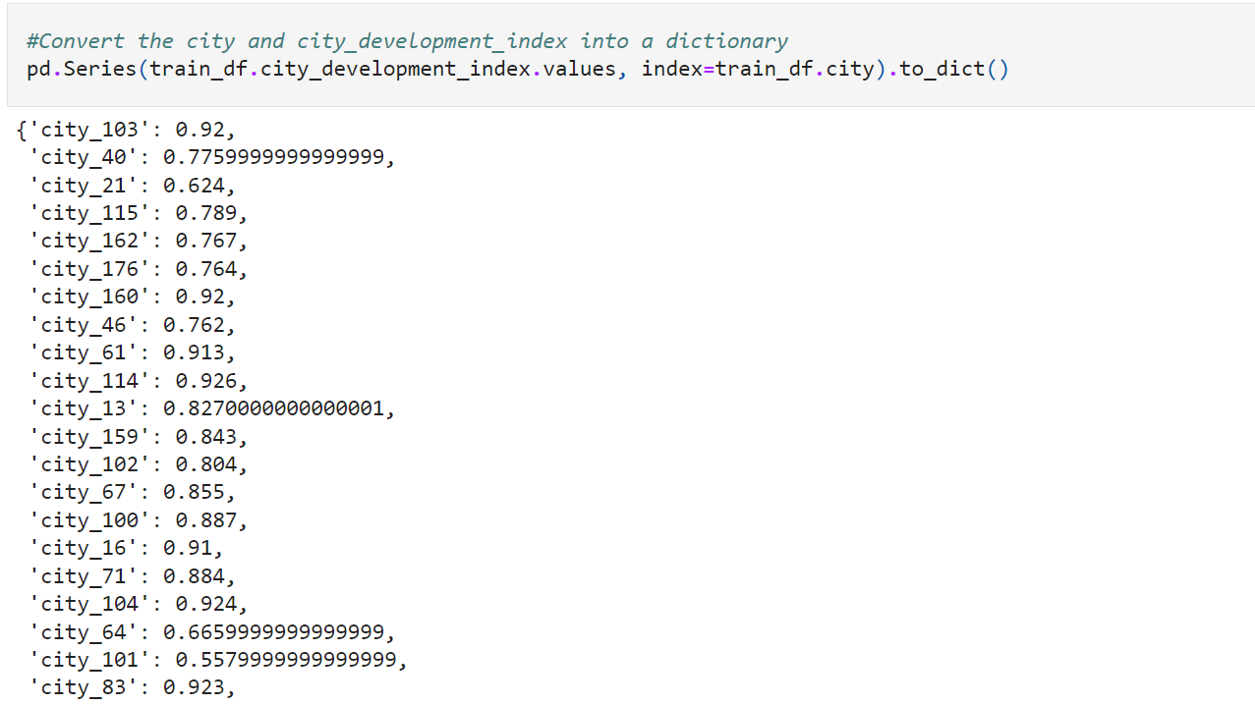
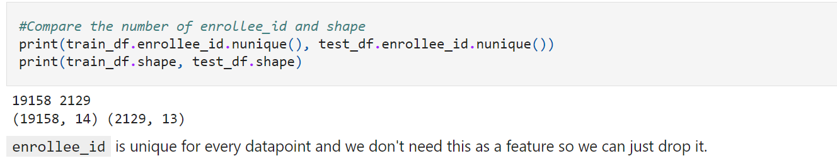
Dropping Irrelevant Columns
Dropped Columns | Reason
Enrolled_Id | Unique for every datapoints
City | Too many categories Direct relationship with city_development_index
Notes:
We noticed that enrolled id is unique for every person. Therefore, it does not have any significant value to our problem. Moreover, city has too many distinct categories which we find it difficult to tackle and it also has a direct relationship with city development index. Hence, we will drop these two columns.

Slide 8
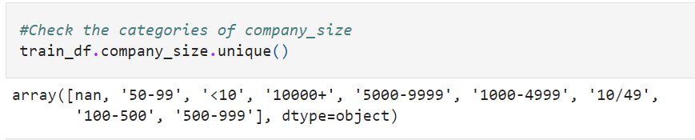
Label Renaming
’10/49’
‘100-500’
’10-49’
‘100-499’
Notes:
Before we fill the missing values, we also did some label renaming to standardize the labels such that they become more concise and unambiguous. Take company_size as an example, we have renamed two of the categories such that all the labels look clean and tidy.

Slide 9
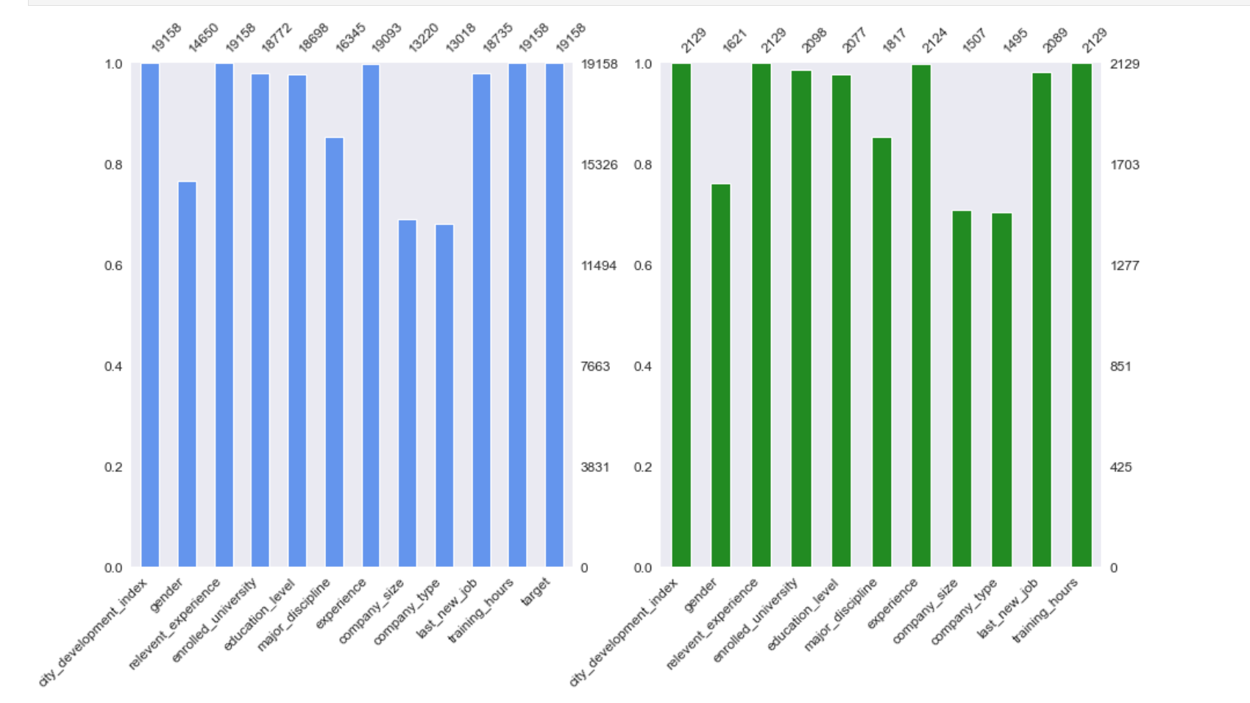
Missing Value Visualisation
Notes:
After that, we need to know the amount of missing value in each variable, so we plot a graph representing the number of missing values.

Slide 10
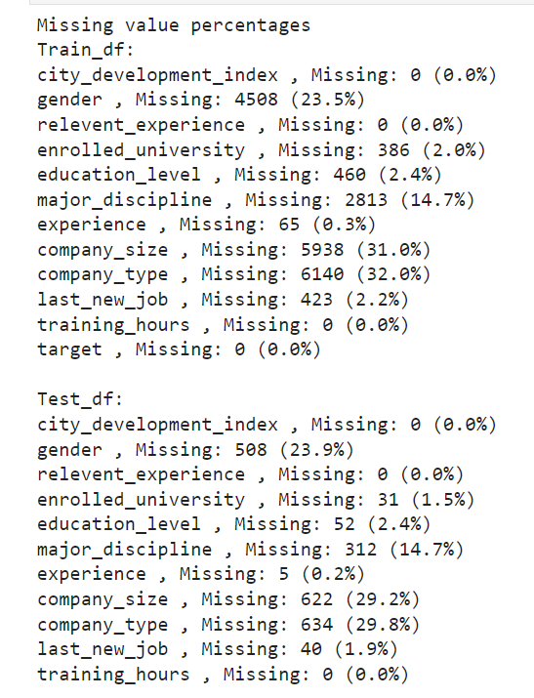
gender
major_discipline
company_size
company_type
Cannot drop directly: require other methods to deal with them
enrolled_university educational_level
experience
last_new_job
< 3%: Can drop directly
Notes:
We convert the numbers into percentages to get a better insight. From the results, we can see that there are 4 features that have less than 3% of missing value. We can drop the rows which have missing values of these 4 features because they will not affect much to the entire dataset. Besides that, we also notice that there are 4 features that have significant numbers of missing values. In this case, instead of dropping all of them directly, we will use other methods to deal with them.

Slide 11
Filling Company_size and Company_type
IF last_new_job == “never” &&
company_size == company_type == nan
No Employment
company_size = company_type = “No company”
Notes:
For company size and company type, we can use last new job to fill some empty values. Since last new job indicates the difference in years between a person’s previous job and current job, if the person does not have any job changing experience and he currently does not have any company size and company type, we can deduce that this person does not have any employment yet. Therefore, we will indicate his company type and company size as no company.

Slide 12
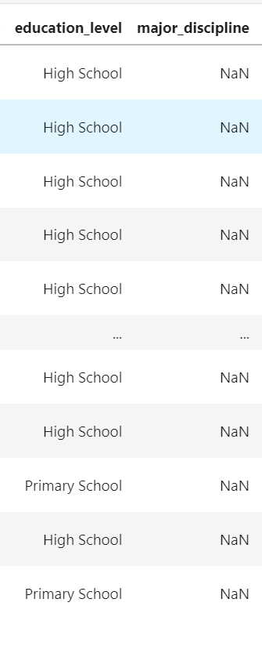
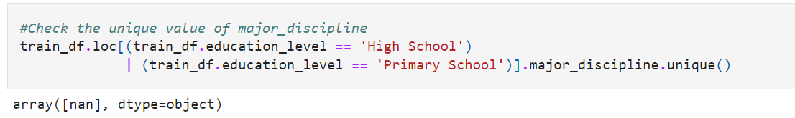
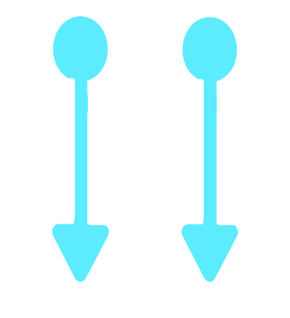
Filling Major_discpline
Primary School & High School
No Major Discipline
Notes:
Next, in order to deal with the missing values in major discipline, we compare it with education level and we observe that a person with either a primary or high school degree does not have any major discipline. Hence, we can simply replace all the nan values in major discipline with no major discipline if the person only has either primary or high school degree.

Slide 13
Filling Remaining Missing Values
gender
“Unspecified”
company_size
“Missing”
company_type
“Missing”
Notes:
After that, for the remaining missing values we substitute them with missing indicators because we do not want to drop them directly as they still contribute to a big portion to the dataset. Next, I will pass to wei kai to elaborate on EDA.

Slide 14
ANALYTIC VISUALISATION

Slide 15
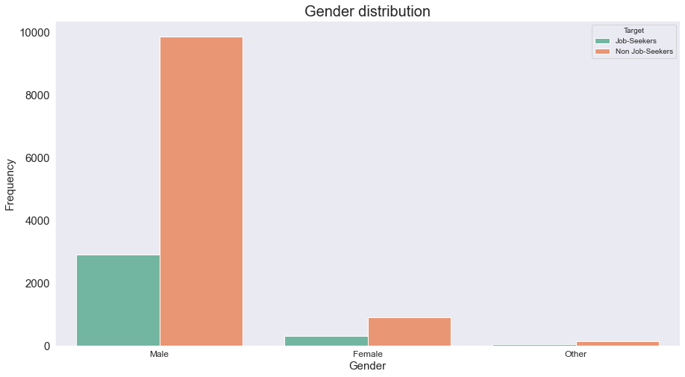
Gender Distribution Between Job-seekers and Non Job-seekers
Male dominated the dataset.
This tells us that data science is more popular among Males.
Notes:
First we will look that the gender distribution between jo-seekers and non job-seekers, we found out that we have a male dominated dataset and this tells us that data science is more popular among Males.

Slide 16
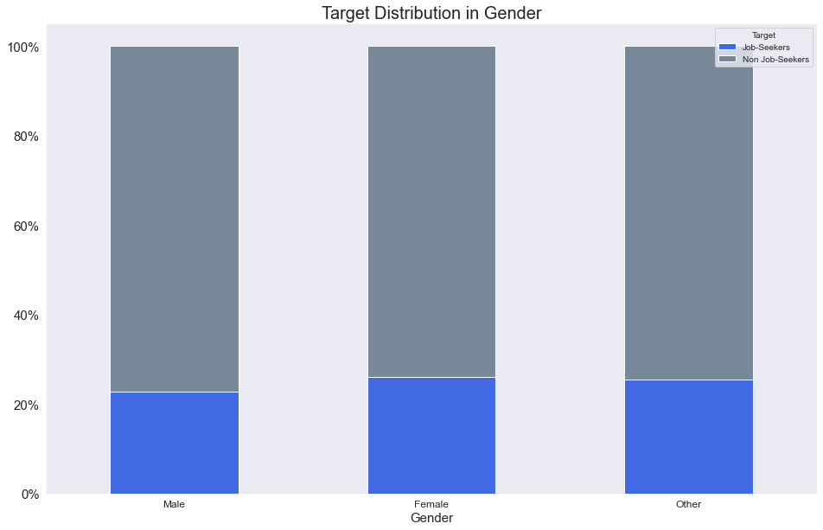
Target Distribution in Gender
About the same ratio for each gender category at 22-25%.
Gender is not a key factor of Job-changing
Notes:
Next, we will check the percentage of Job-Seekers in each category.
From the graph, it seems that each category of gender shares about the same ratio of which is approximately between 22~25% of job-seekers. Hence, we can deduce that gender is not a key factor of Job-changing.

Slide 17
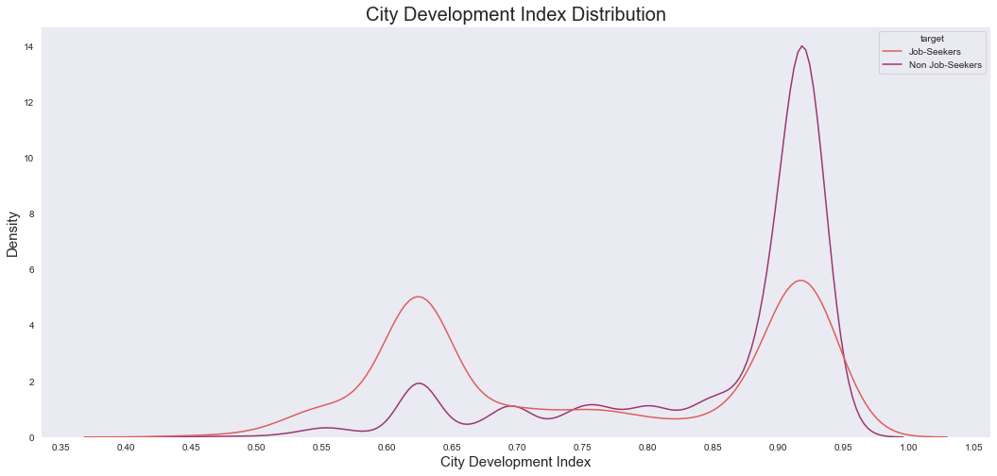
City Development Index Distribution
2 Spikes at 0.60 ~ 0.65 and 0.87 ~ 0.95
Most reside in the 2 ranges
Higher CDI less likely to find jobs, Lower CDI more likely to find jobs
Higher CDI cities may have other better jobs resulting in less interest in seeking the job
Notes:
Now we look the Distribution for City Development Index, Interestingly, we can see that there are two spikes in the graph, one is around 0.60 ~ 0.65 and the other is around 0.87 ~ 0.95. This means that most of the people live within these two ranges. A significant observation is that people who live in the higher CDI cities are less likely to find new jobs whereas people who live in the lower CDI cities tend to seek new jobs.The reason maybe higher CDI cities can provide more stable and lucrative jobs so the people will have less interest in job-seeking. On the other hand, lower CDI cities are not as advanced and developed as the higher CDI cities so they are unlikely to provide satisfying jobs for the people.

Slide 18
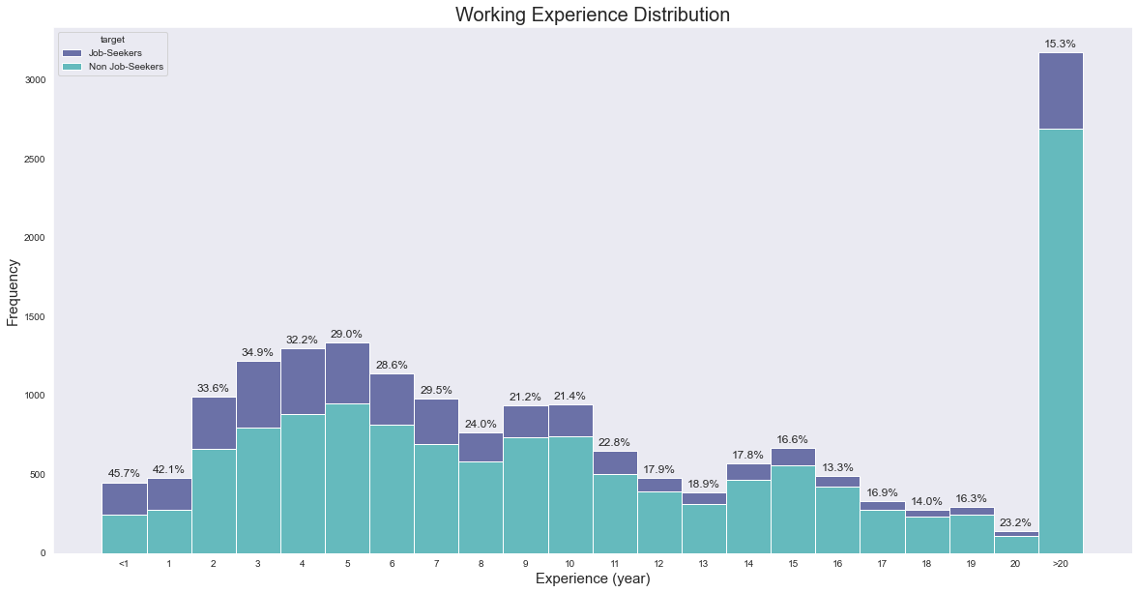
Working Experience Distribution
Majority have more than 20 years of working experience
Lesser working experience, higher proportion seeking the job
Notes:
Now we will look at the working experience distribution. From the graph, we can see that majority of people have more than 20 years of working experience and the rests are mostly distributed between 2 ~ 7. We notice that among the people who have less years of working experience, the percentages of Job-Seekers are relatively higher than the people who have more years of working experience. This is understandable as people who have less work experience are less likely to be in a stable state because they have stronger aspirations to achieve better career goals. That's why they want to participate in the training programs to gain experience and build their skills so that they can reach a higher level on their career paths. However, people who have been working for a long time will have less interest in job-seeking because they have already statisfied with their current circumstances and they lack of the motivations to pursue new career. Therefore, they main purpose of training is to upgrade their skills and increase their work performances in their current jobs.

Slide 19
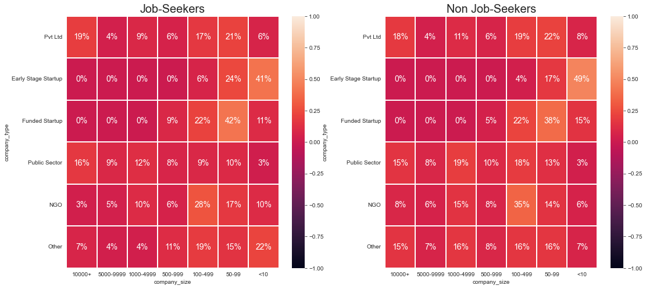
Distribution between Company Type and Company Size
Notes:
We realised that for different company types, the spread of company size is different.

Slide 20
Association between Company Type and Company Size
Cramer’s V to test the strength of association between Company Type and Company Size
Cramer’s V value of more than 0.5 indicates a strong association
The Cramer’s V value was 0.52
Stong association between Company Type and Company Size
Notes:
We used the cramer’s V to test the strength of association between Company Type and Company Size, and a Cramer’s V value of more than 0.5 indicates a strong association,
We got a value of 0.52 showing there is Strong association between Company Type and Company Size. This is expected as company types like startups would generally have a smaller company size while other company types would have a higher proportion at certain ranges.

Slide 21
Data Charts Infographics
Venus
Mars
Saturn
90%
75%
60%
70%
40%
85%
80%
100%
60%
2020
2021
2022
Venus is the second planet from Sun
Mars is a cold place full of iron oxide dust
Saturn is a gas giant and has several rings

Slide 22
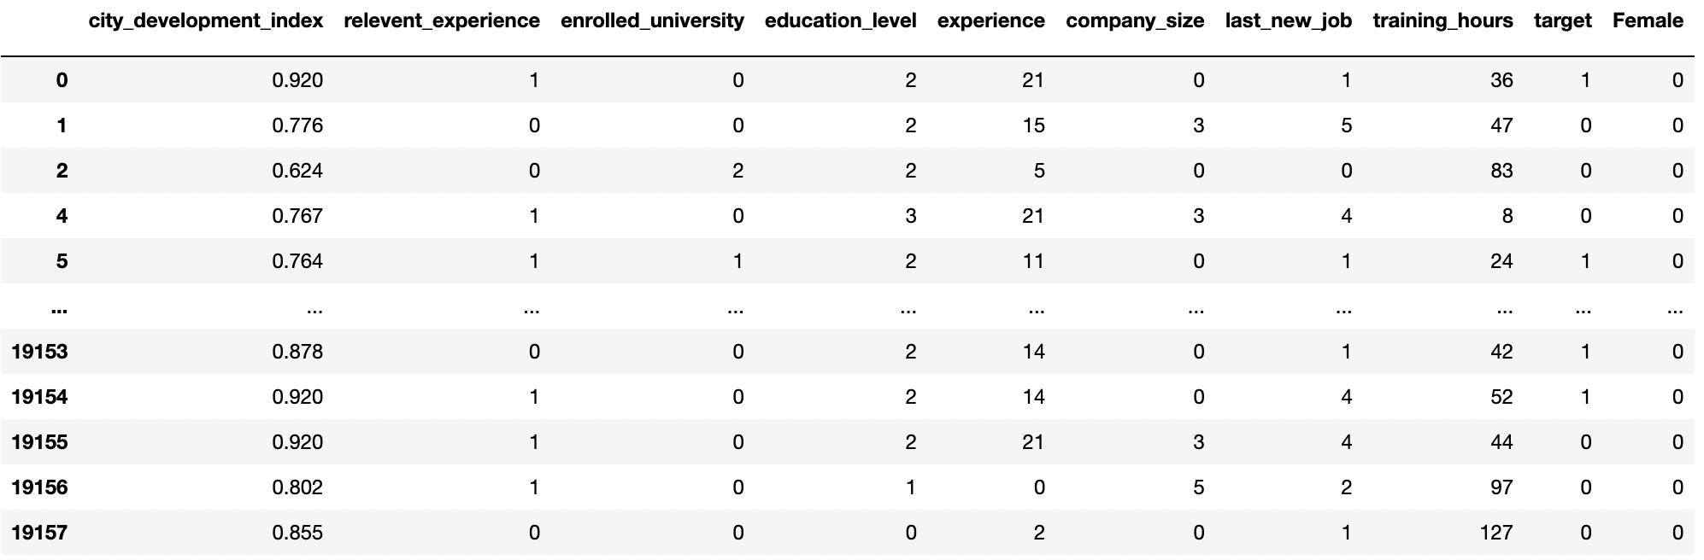
Encoding
One-Hot Encoding
Label Encoding
Gender
Major Discipline
Company type
Experience
Enrolled University
Education level
Experience
Company size
Last new job

Slide 23
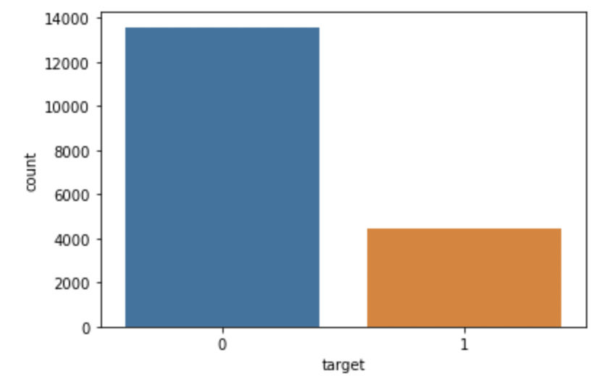
Imbalanced Dataset
Target 0
Non job Seeker
Target 1
Job Seeker

Slide 24
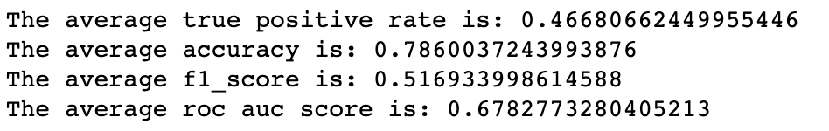
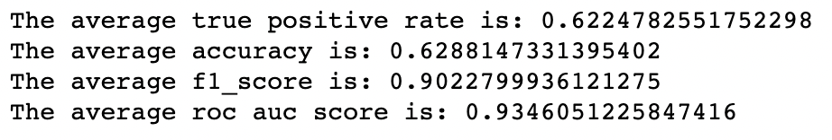
Try to penalize the model
Kfold average performance
Random Forest
78.6%
SVM(weighted)
62.2%

Slide 25
Under Sampling

Slide 26
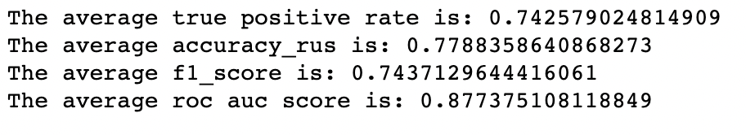
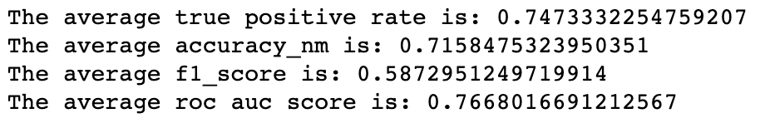
Under Sampling Strategy
Using Random Forest
Kfold average performance
Random Under Sampling
77.9%
Near Miss
71.5%
Notes:
NearMiss-1 selects examples from the majority class that have the smallest average distance to the three closest examples from the minority class.
NearMiss-1 selects the positive samples for which the average distance to the N closest samples of the negative class is the smallest.

Slide 27
Over Sampling

Slide 28
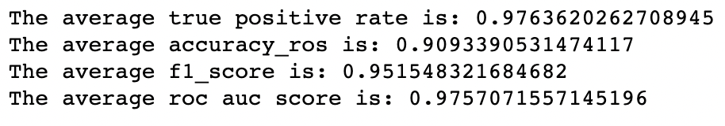
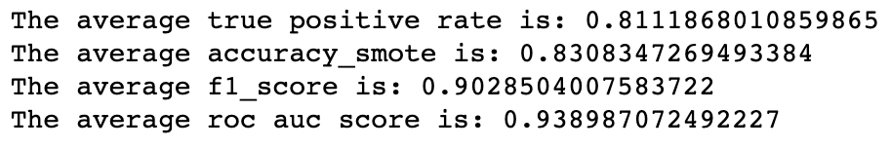
Under Sampling Strategy
Using Random Forest
Kfold average performance
Random Over Sampling
90.9%
SMOTE
83.1%
Notes:
Choose a minority class as the input vector
Find its k nearest neighbors (k_neighbors is specified as an argument in the SMOTE() function)
Choose one of these neighbors and place a synthetic point anywhere on the line joining the point under consideration and its chosen neighbor
Repeat the steps until data is balanced

Slide 29
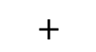
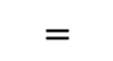
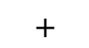
Boosting
Final predictor
$$=$$
Tree 1
$$+$$
Tree 2
$$+$$
Tree 3

Slide 30
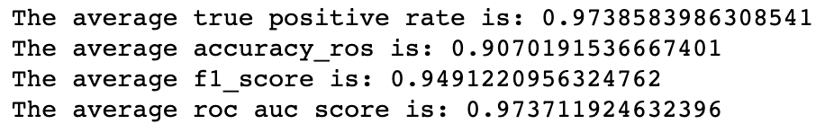
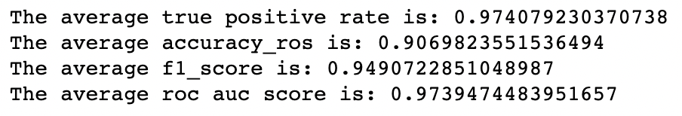
Boosting Strategy
Kfold average performance
Light Gradient Boost
90.7%
XGBoost
90.7%
Notes:
Choose a minority class as the input vector
Find its k nearest neighbors (k_neighbors is specified as an argument in the SMOTE() function)
Choose one of these neighbors and place a synthetic point anywhere on the line joining the point under consideration and its chosen neighbor
Repeat the steps until data is balanced

Slide 31
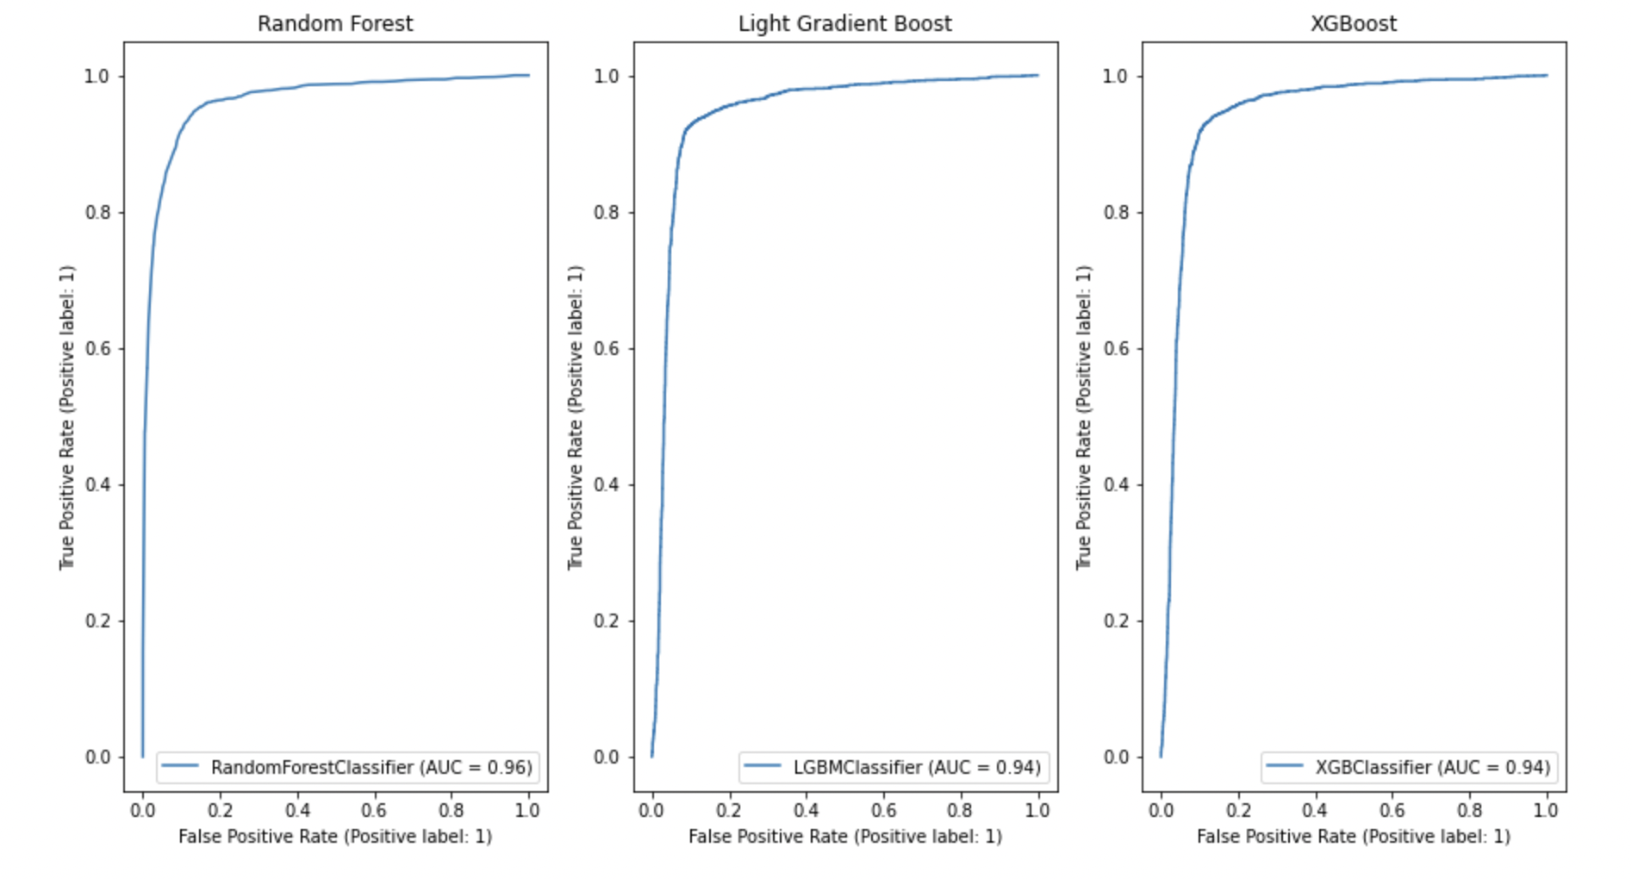
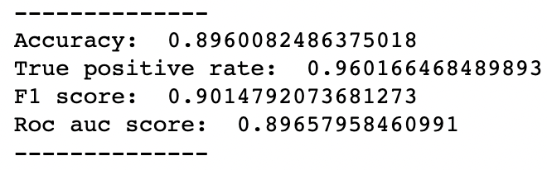
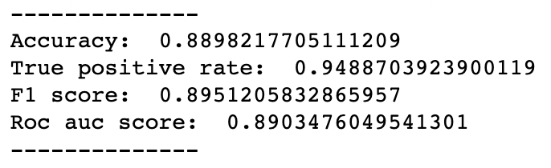
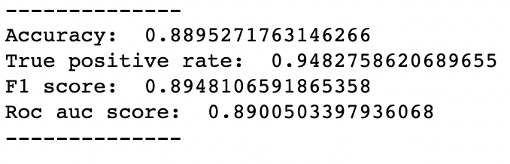
Performance on the whole dataset
Random Forest
Light GBM
XGBoost
Notes:
One way of interpreting AUC is as the probability that the model ranks a random positive example more highly than a random negative example.

Slide 32
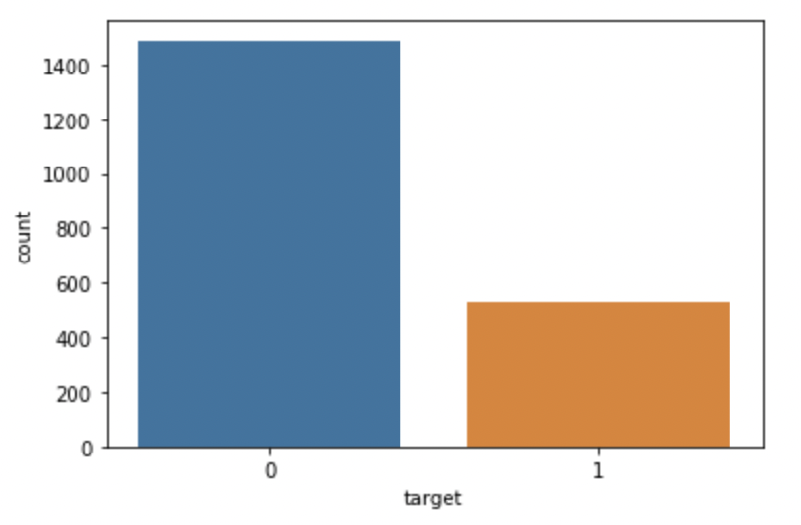
Imbalanced Prediction Dataset
Target 0
Non job Seeker
Target 1
Job Seeker

Slide 33
Conclusion
What we learn
Kfold validation to tune the model and see the average performance of the model
Different strategies to handle the imbalanced dataset
Boosting method for trees
Different metrics such as the roc curve and f1 score for classification
Outcome of our model
Using in HR analytics to predict whether someone is looking for a job
Insights in the dataset that helps HR
- Location of the person
- Working experience

Slide 34
Thank you !
Max Tan Han Xian
Wong Wei Kai
Zhang Kaichen

